Slide 1
Speaking
Part 2 Long turn
(Presentation created by Lőrincz Tünde)

Slide 2
Find a study buddy to practise speaking with.
It may seem easier to practise speaking when you’re studying in a classroom with other students. However, there are many ways you can practise from home, too.
Find another student who also wants to practise and:
• Record and share → email, WhatsApp, Dropbox, Google Drive or similar tools.
• Find a time to practise speaking live to your study buddy.
• Use video conferencing tools to speak live to your study friend. You can share pictures on your screens and create your own practice speaking tasks.

Slide 3
Practice 1: Compare two (of three) photos
1. Set a timer for one minute. (You could use a kitchen timer, the clock app on your mobile phone, or search online for “one minute timer”.)
2. Prepare to record yourself. (There is free and simple software for most mobile phones and computers which you can use to record your voice.)
3. Look at the pictures below of people studying in different environments. Talk about the ways these are similar to or different from each other.
4. Start the timer, start recording, and speak about the photos until the timer rings.
5. This is a practice run, and not a test. Record your speaking a few times until you’re happy with your speaking and the recording.
6. Save your favourite recording.

Slide 5
Reflect: How can you improve?
1. Were you able to speak for one minute? Did you pause or repeat yourself?
2. How easy / difficult was it to speak for one minute? Why?
3. What did you do well? Think about: grammar, vocabulary, pronunciation and how clearly you organised and expressed your ideas.
4. If you are working with a study buddy, exchange your recordings.
a. Ask for feedback on your speaking.
b. Give them feedback on their recording.
c. Tell them two good things about their speaking and one thing to continue working on.

Slide 6
About the exam -- True or false?
1. The questions the examiner asks you are also written above the photos.
2. You should describe the photos in lots of detail.
3. Each student will get a unique set of photographs to talk about for one minute.
4. You can only hear the instructions once.
True
False
True
False

Slide 7
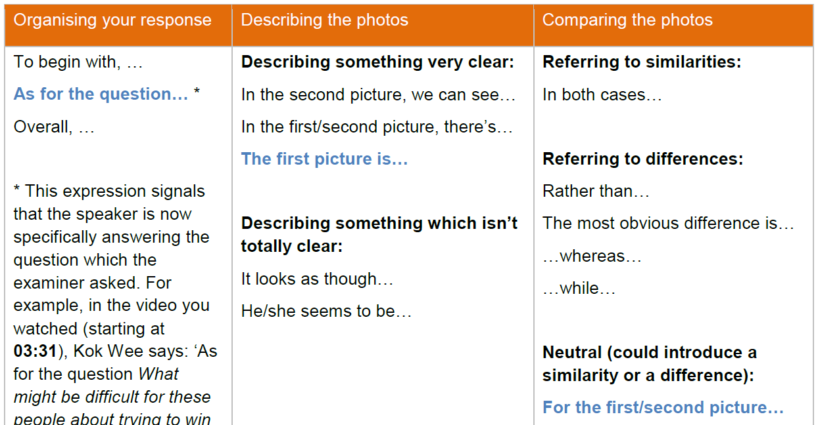
Useful vocabulary

Slide 9
Practice 2:
Now let us look at a real Speaking part 2 task

Slide 10
1

Slide 11
2
Which of these activities do you find most helpful yourself in learning?
1. Look again at the two pictures and the question: Which of these activities do you find most helpful yourself in learning?
2. Set a timer, start recording, and speak for 30 seconds to answer this question.
3. Try this a few times until you’re happy with your speaking. Record each attempt, then listen to them all and choose your best one.
4. Save your favourite recording.
5. Evaluate this recording. Use the following assessment criteria that are used in the real Speaking test.

Slide 12
Assessment criteria
Grammar and Vocabulary: Are you using a wide range of grammatical structures and vocabulary? Are you using these structures and vocabulary correctly? Are you using vocabulary which is appropriate for a range of familiar and unfamiliar topics?
Discourse Management: Is everything you say relevant to the task? Are your ideas expressed clearly? Are you using varied language to link and organise your ideas? Are you able to speak with ease and with very little hesitation?
Pronunciation: You don’t need to have an English accent, but it is important to be clear. Are you pronouncing individual sounds clearly? Are you placing stress on the right parts of words and on the right words in sentences? Does your voice go up and down at the right times?

Slide 13
Assessment criteria
Interactive Communication: Are you listening to the other candidate and answering in a way that makes sense? Can you think of new ideas to add to what they said? Do you negotiate towards an outcome (when you need to make a decision)?
Global Achievement: This is about your general performance. How well are you speaking about the topics you are given (including unfamiliar and abstract ones)? Are your answers clear? Can you express complex ideas and concepts, and is your discourse easy to follow?

